Slide 1

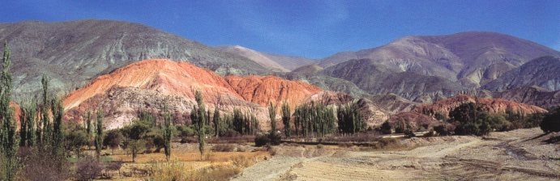
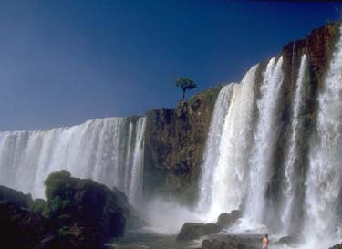
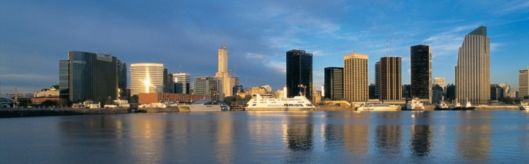

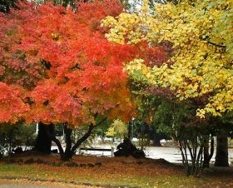
September 5-9, 2016 Buenos Aires, Argentina
We cordially invite you to Buenos Aires!!!
fmv-uba.org.ar/SIHM/

